Slide 1
Launch your success with the Success Center
How to log in to estorm, register for SWIC alert, log in to BrightSpace, access online tutoring, check your email and use office365

Slide 2
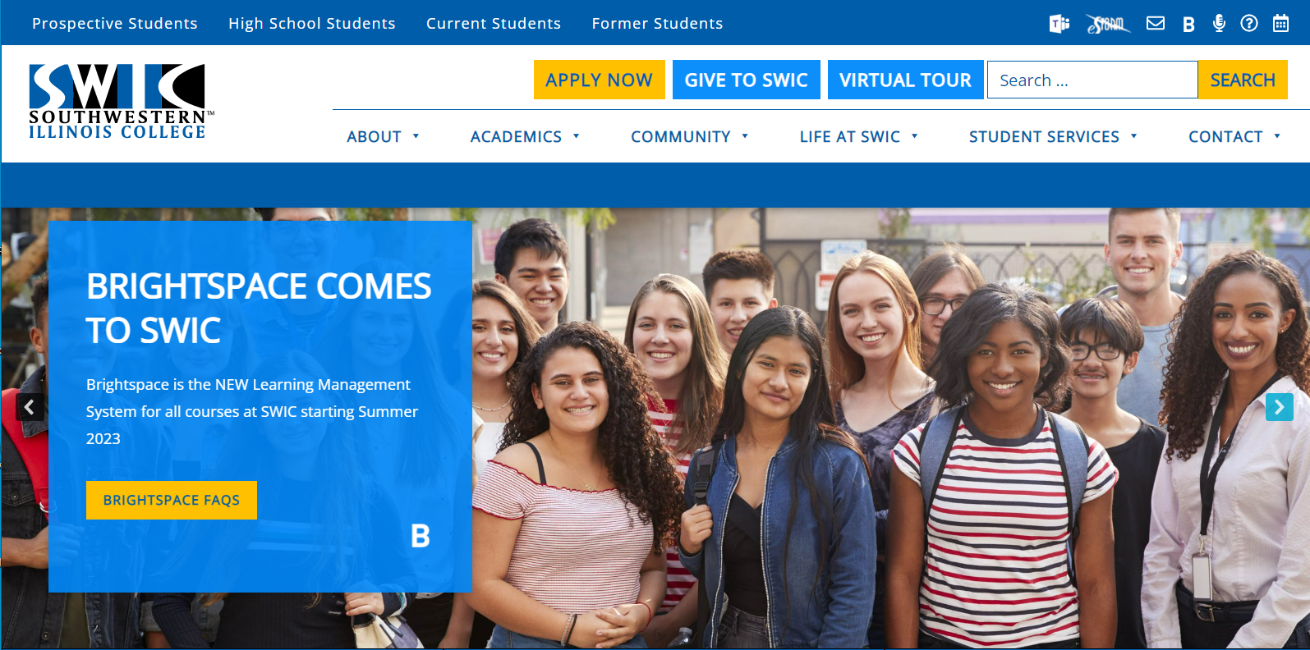
Accessing your student technology begins with estorm

Slide 3
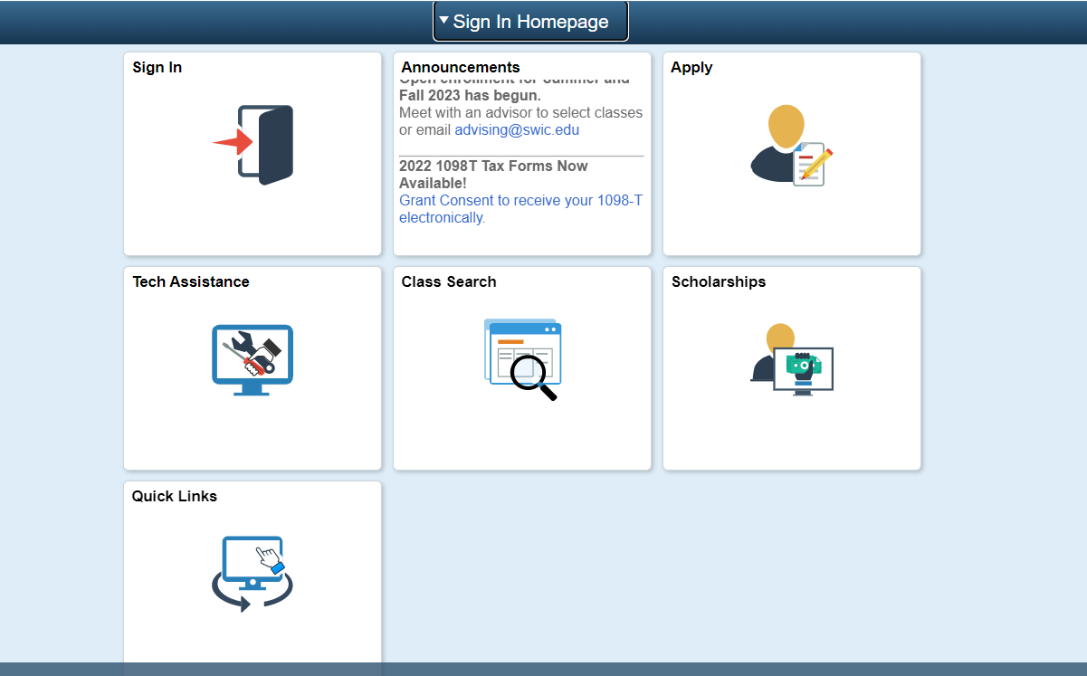
Click the sign in tile

Slide 4
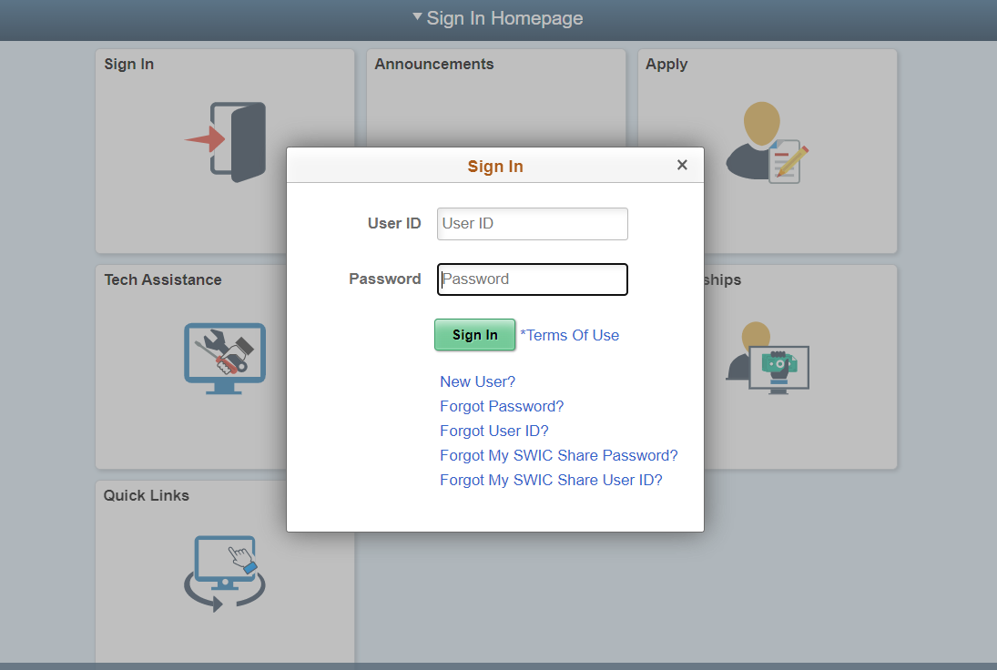
Enter your student id and password

Slide 5
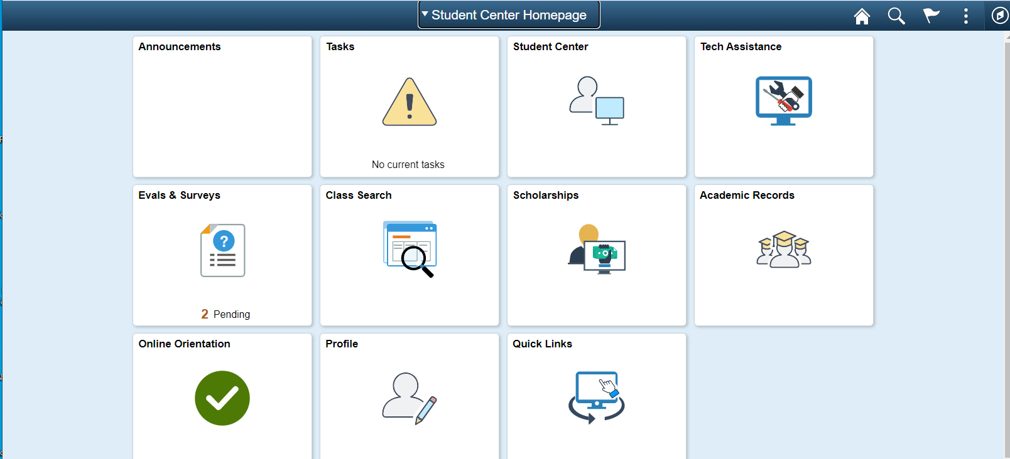
This is your student center homepage

Slide 6
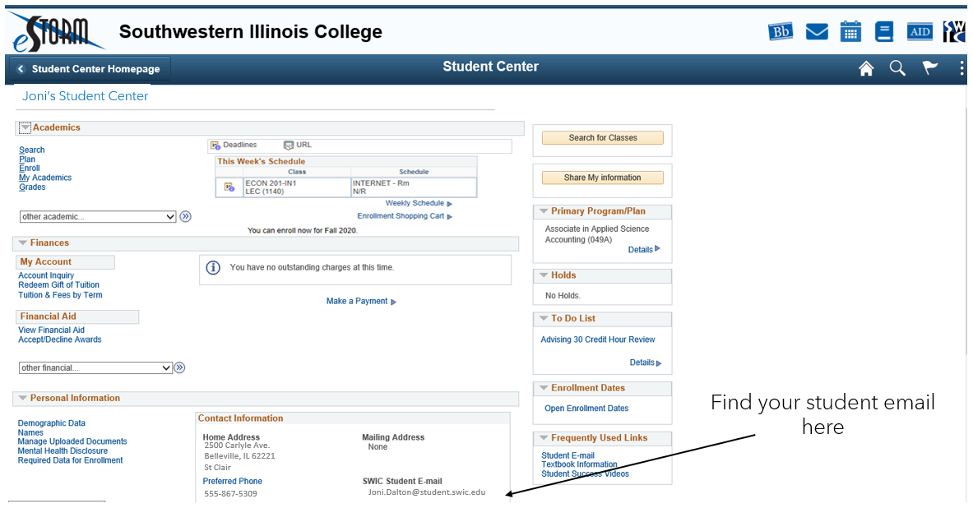
Student Center homepage

Slide 7
From your Student Center Homepage you can:
See your student details
Search for classes
Check on your scholarship applications
Complete Evals & Surveys if available
Complete your Online Orientation
Check your Quick Links

Slide 8
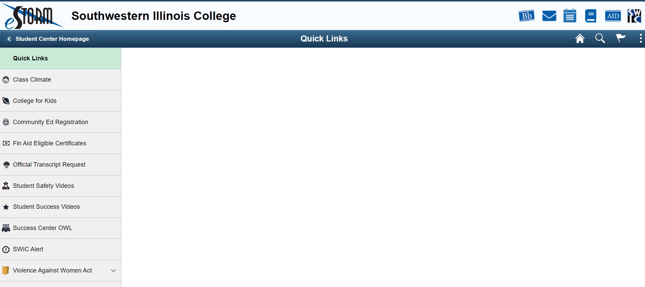
Quick links
Where to check your Financial Aid
See your transcripts
Student safety videos
Student Success videos
Where to submit papers to have them reviewed by the Success Center
Register for SWIC Alert here

Slide 9
SWIC alert
Use your eStorm login to register for SWIC Alert
This alerts you when the campus is closed due to weather, building issues, etc.
Alerts you when there is a situation on campus that you need to be aware of
Your registration for SWIC Alert is good for two years
If you change your contact information, please update your SWIC Alert

Slide 10
How to log in to Brightspace
From SWIC webpages,
click B in upper right corner

Slide 11
How to use Brightspace
Use your eStorm username and password to log in to Brightspace
All of your classes will be in Brightspace
You can find your course syllabi here as well as your instructor contact information
The Support Services drop down menu has links to Online Tutoring and After Hours Tutoring

Slide 12
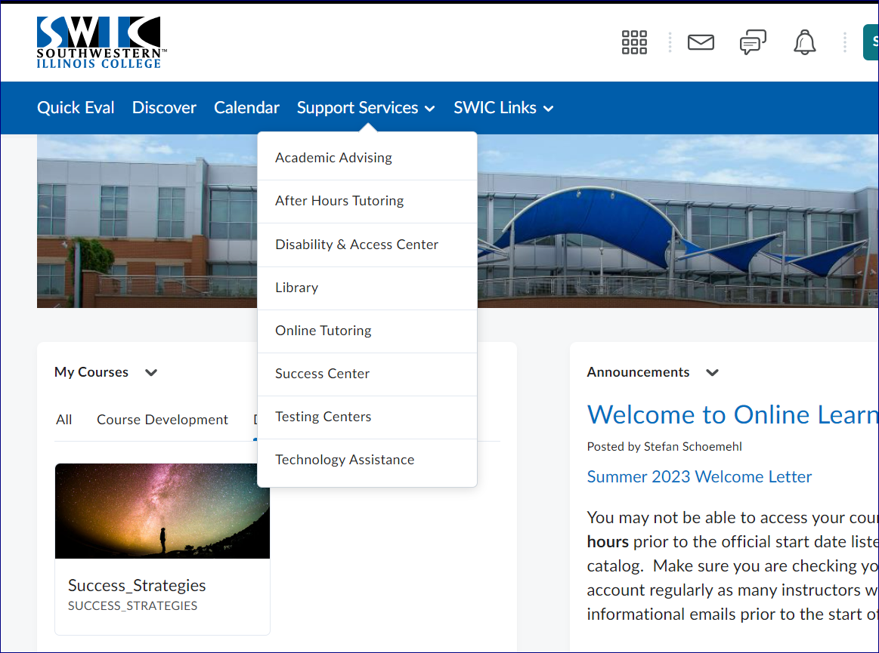
Online Tutoring
Click here to access online tutoring.
Online Tutoring is available through Microsoft Teams via same-day appointments.

Slide 13
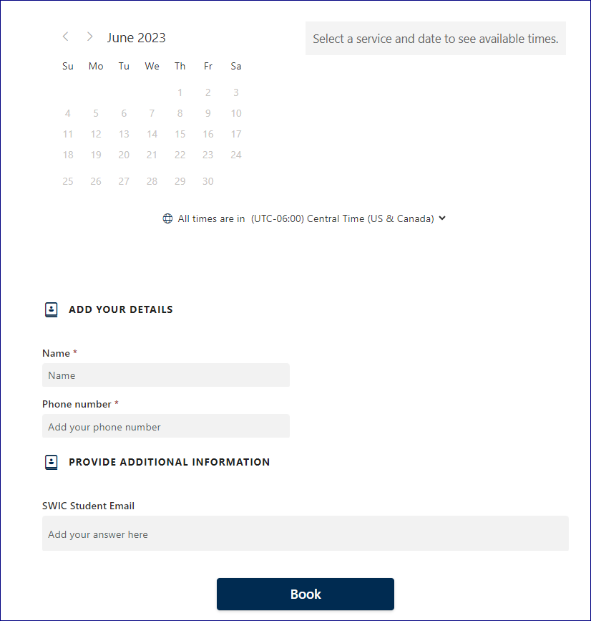
Accessing Online Tutoring
Online tutoring appointments can be scheduled through this page.
Choose the staff/subject area you would like, date, time, and add your details.

Slide 14
After Hours Tutoring
When the Belleville Success Center is closed, after hours tutoring is available during evenings and weekends.

Slide 15
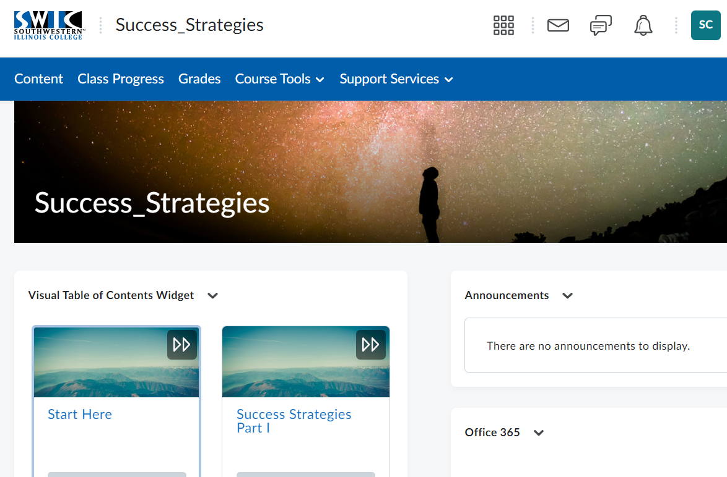
Student email and Office365
Click here to access your student email and Office365
Or add it as a widget on your Brightspace Homepage

Slide 16
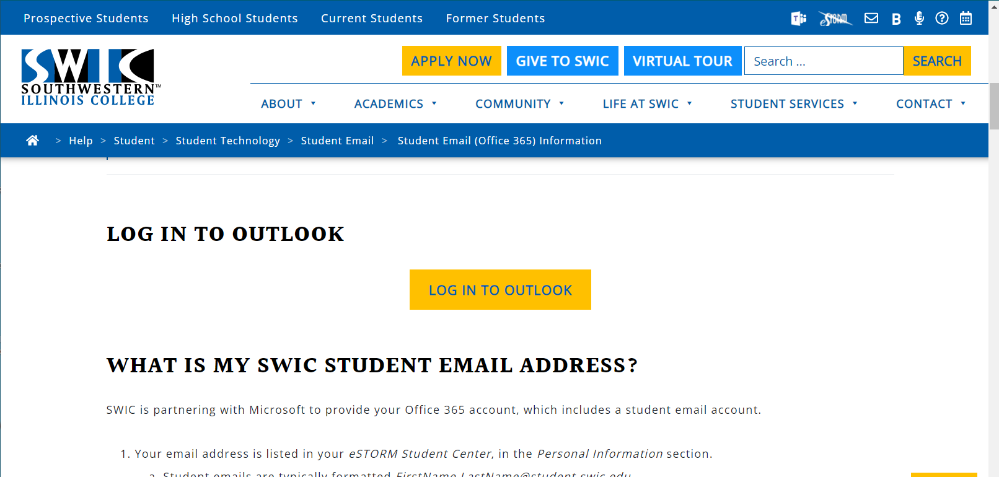
Scroll down until you see the LOG IN TO OUTLOOK and click on it

Slide 17
Using Office 365 Email
Your email address is listed in your eSTORM Student Center, in the Personal Information section.
SWIC is partnering with Microsoft to provide your student email account.
If you are already logged in to a Microsoft email account, you must log out of that account before you can access your SWIC student email account.
Use your eStorm password with your student email address to log in to your email.
Use your student email to communicate with your instructors and include your class name in subject line.
This gives you access to Office365, including downloading it to your personal computer, for as long as you are an active student at SWIC.
You can save your papers / files on your One Drive to use on any computer. One Drive auto saves every seven seconds, so you won’t lose your paper in a power outage or computer crash.

Slide 18
Connecting Office 365 to Brightspace
Copy and paste the link below to a web browser or Ctrl+Click to watch the tutorial.
https://screenpal.com/watch/c0hb2KVAZ7i

Slide 19
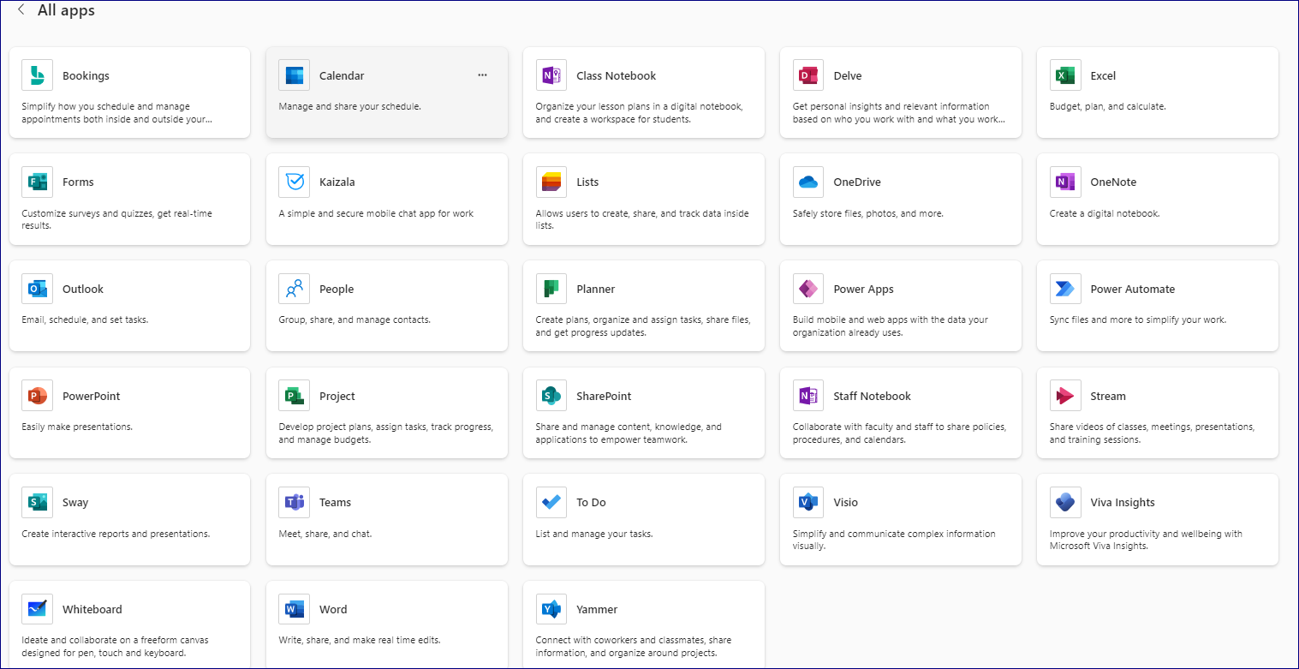
Office365 apps
Save your papers and files here
SWIC is now using Teams to access other SWIC students and instructors in an audio-video format

Slide 20
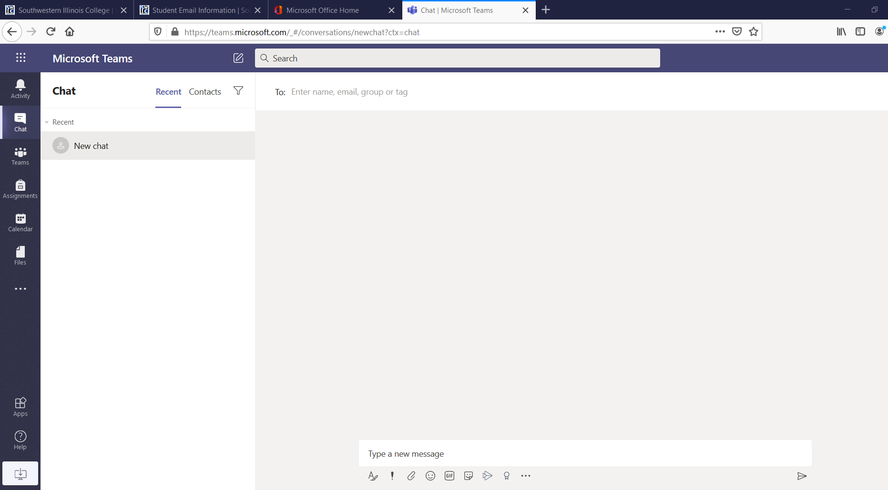
Teams home page
Enter instructor’s information and other student’s information to connect with them through Teams.
Begin your chat here

Slide 21
You can also access your SWIC technology here

Slide 22
Questions?
If you have any questions about this presentation or need help with your classes, please contact the Success Center at:
SuccessCenters@swic.edu
or
618-222-5495
The Success Center team at Belleville, Sam Wolf Granite City and Red Bud Campus Success Centers look forward to working with you!

