Slide 1
SWIC Online Application *YOU NEED YOUR SOCIAL SECURITY NUMBER FOR THIS PROCESS*

Slide 2
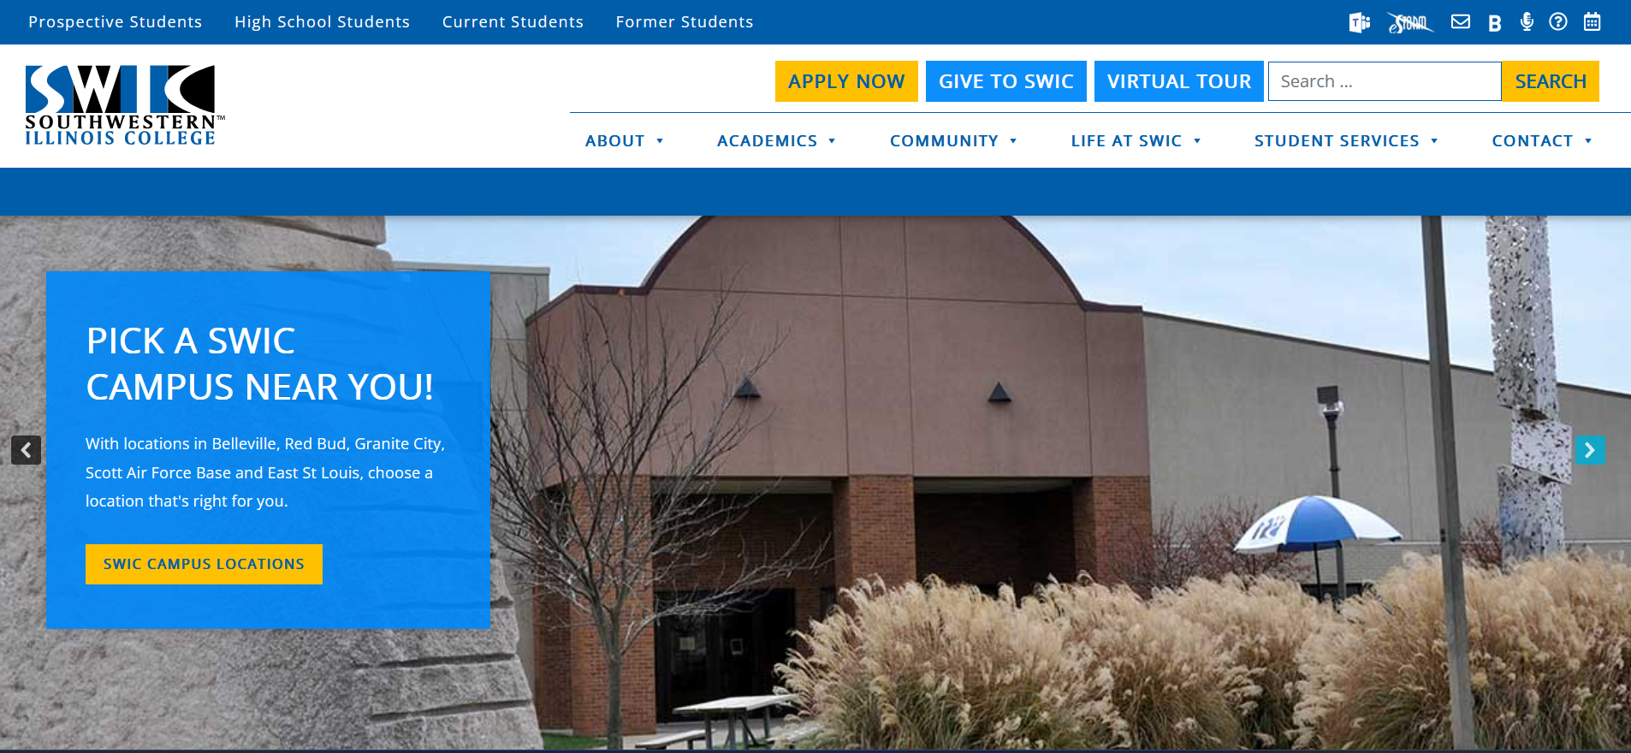
Visit www.swic.edu and click “Apply Now”

Slide 3
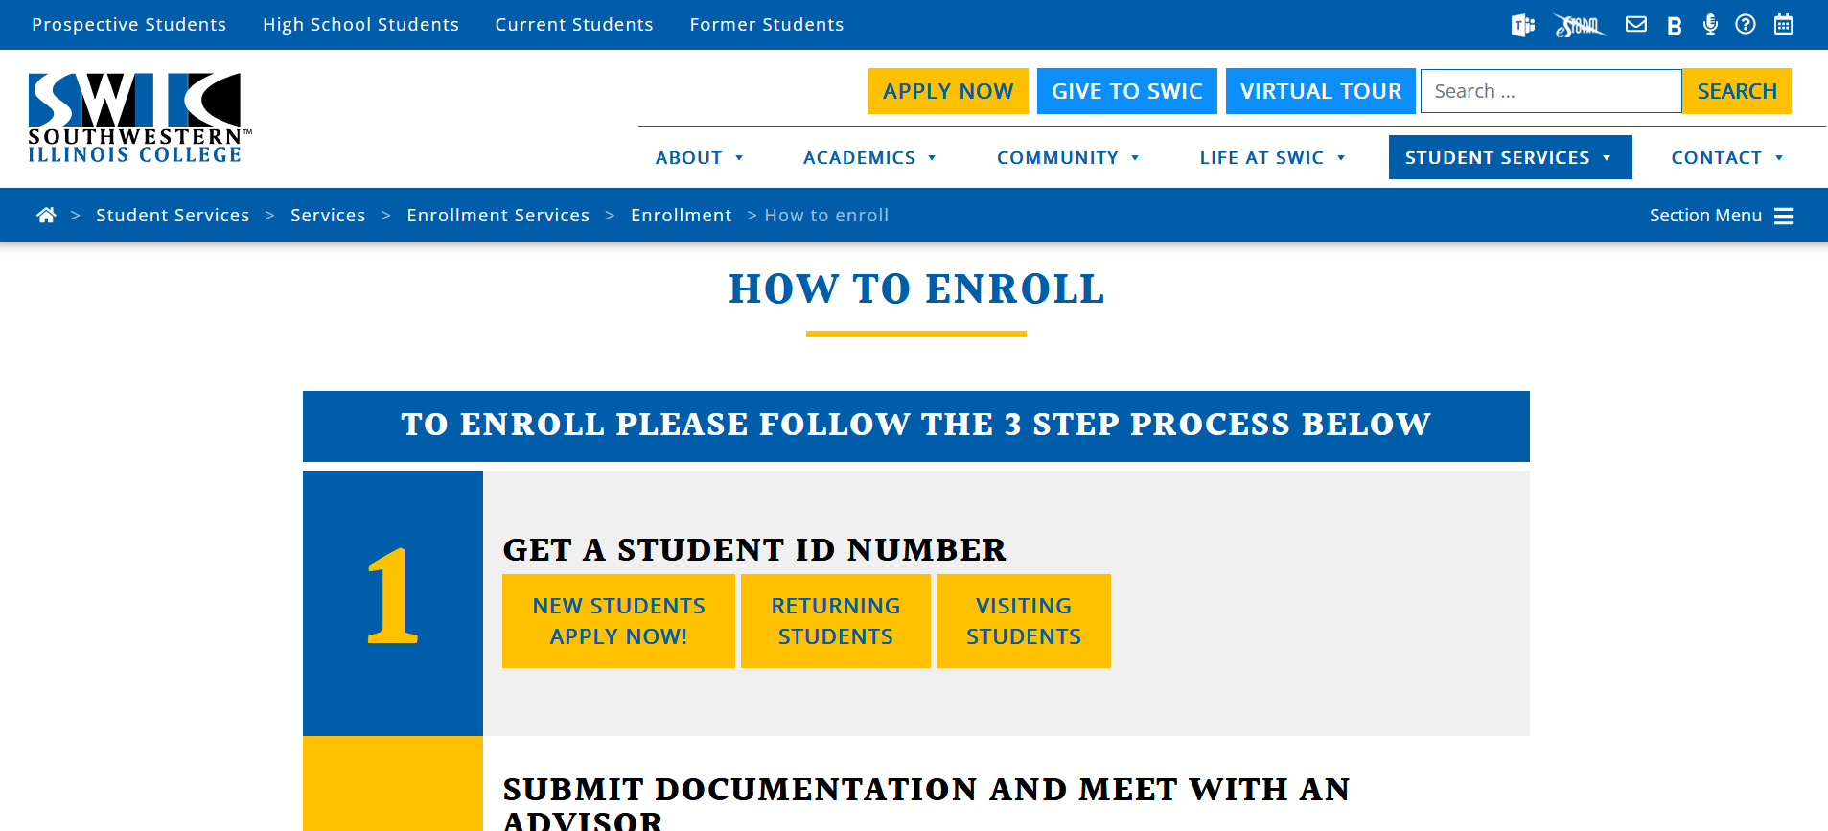
Under step one, select “New Students Apply Now!”

Slide 4
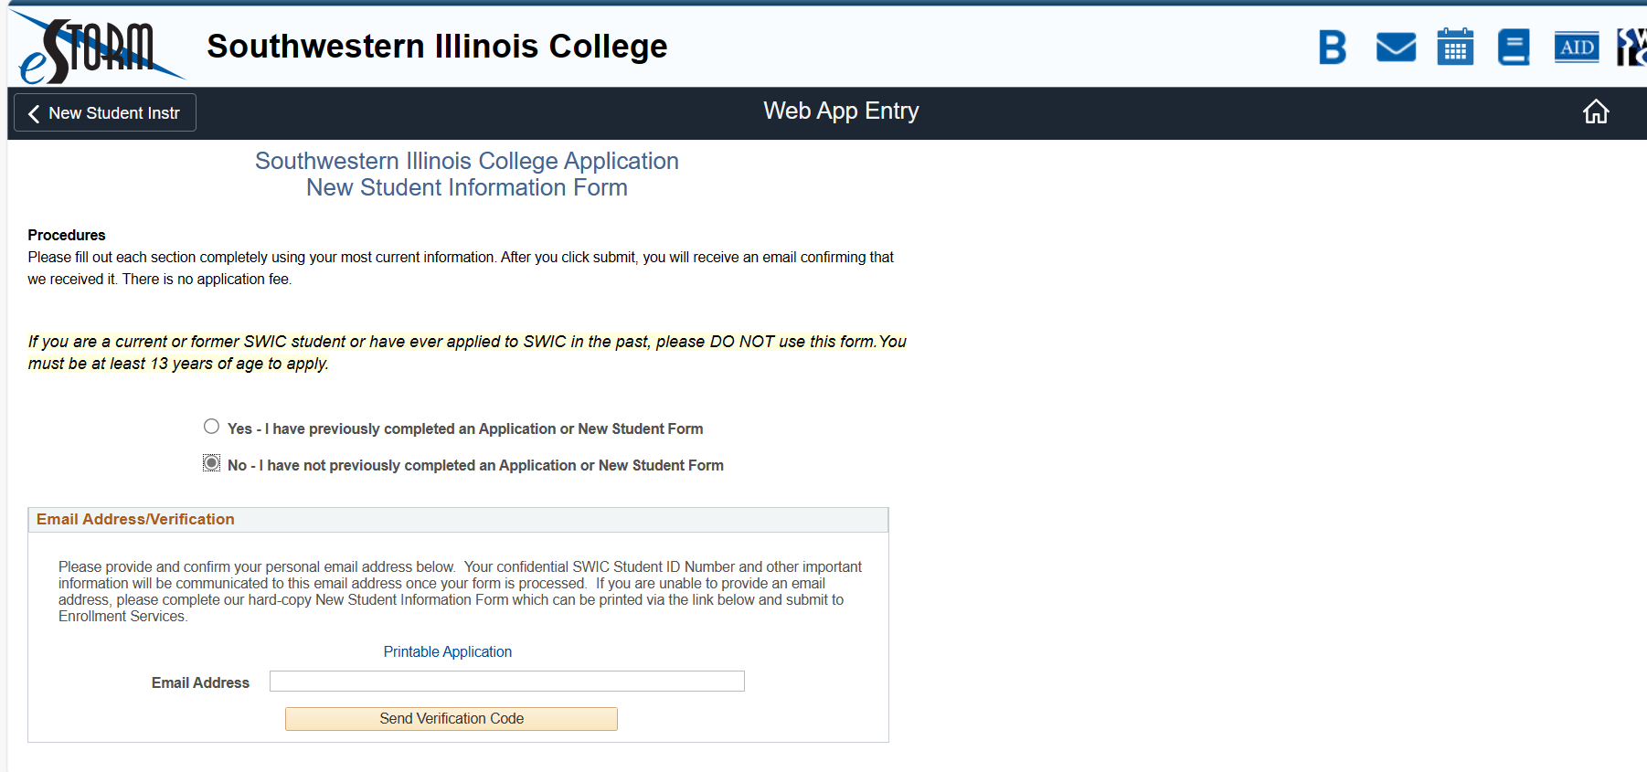
Click “No” on this page, enter an email address, and then click “Send Verification Code”.

Slide 5
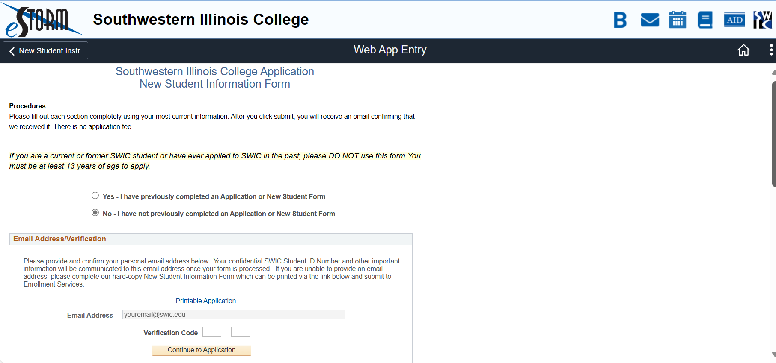
Enter the verification code that was sent to your email address.

Slide 6
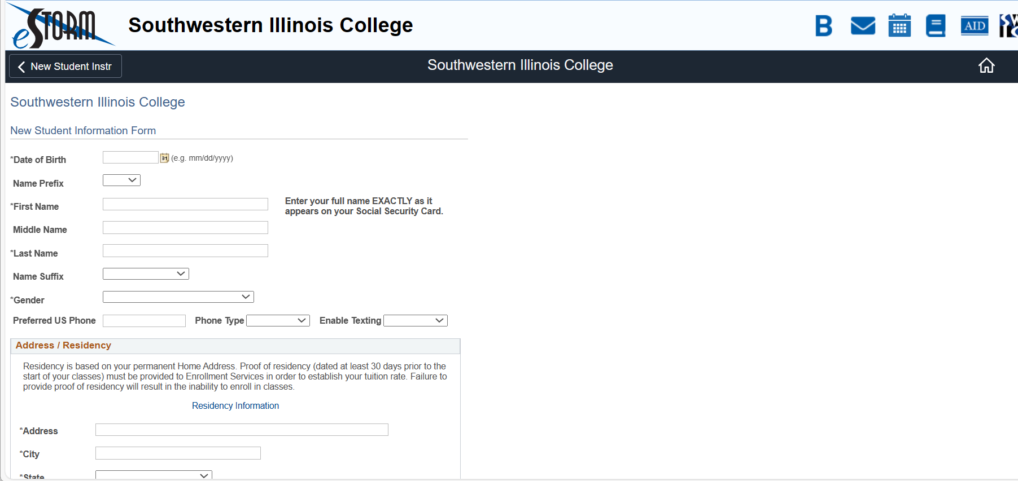
You are now ready to start the application- all information with an asterisk is required.

Slide 7
Completing the form
Type the following
Date of Birth
First Name and Last Name (exactly as it appears on your social security card)
Email address (use a VALID email address)
Address

Slide 8
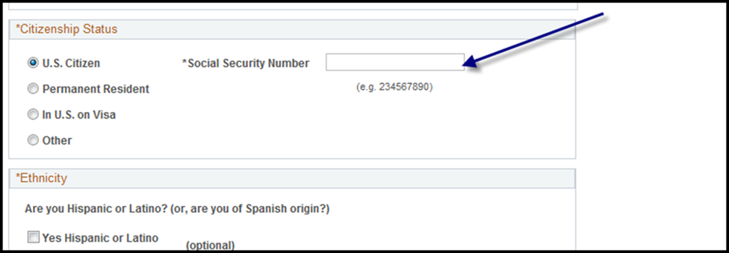
Citizenship Status
Click on the appropriate choice
If you indicated US Citizen, this is where you will enter your social security number (permanent residents will also see this box)

Slide 9
Other citizenship options
Visa holders will complete the box below:

Slide 10
Other citizenship options
Students without social security card numbers, you can still get dual credit!
Please select “OTHER” and make your instructor aware of your citizenship response. They can contact the dual credit coordinator to discuss the next steps.

Slide 11
High School Status
Choose “Still in High School”
A box will appear to the right asking for your expected graduation date. Please enter one of the below options based on your class level:
Freshman – 05/31/2028
Sophomores – 05/31/2027
Juniors 05/31/2026
Seniors – 05/31/2025

Slide 12
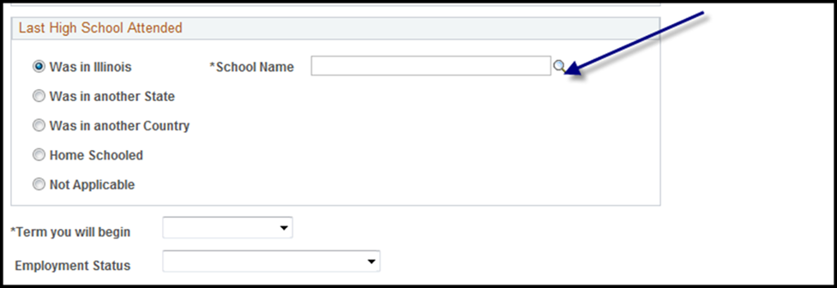
Last High School Attended
Check “Was in Illinois”
Click on the magnifying glass to find your school

Slide 13
Next steps
High school student type - select Dual Credit
Skip the college and university education section
Under “Term you will begin”- it will populate for you
Select the appropriate choice under “Employment status”
Education plans will populate for you so no need to do anything
Select the appropriate choice under “My intent”
Skip the dual admission program section

Slide 14
To complete:
Put a check mark in the box
Enter your full name in the signature box and click submit

Slide 15
Follow-up
Your application is complete and you’ll receive an email in a few days with your SWIC ID number
Once you’ve received your ID number, you will proceed with setting up your eSTORM account
A SWIC dual credit representative will visit your classroom to assist you in completing your class registration. You must have access to your eSTORM account at that time.

